Slide 1
DOM105 2019
Session 11-12
Reading: SfM Ch. 10

Slide 2
Comparing two independent population means when pop. variances are equal, using pooled-variance test
2 samples, size $n_{1}$, $n_{2}$, mean ${\overline{x}}_{1},{\overline{x}}_{2}$, std dev $S_{1},S_{2}$
The hypothesis is that the difference of two means have a certain value
$$df=n_{1}+n_{2}−2$$
$$t_{STAT}=\frac{\left({\overline{x}}_{1}−{\overline{x}}_{2}\right)−\left(μ_{1}−μ_{2}\right)}{\sqrt{S_{p}^{2}\left(\frac{1}{n_{1}}+\frac{1}{n_{2}}\right)}}$$
$$S_{p}^{2}=\frac{\left(n_{1}−1\right)\left(S_{1}^{2}\right)+\left(n_{2}−1\right)\left(S_{2}^{2}\right)}{\left(n_{1}−1\right)+\left(n_{2}−1\right)}$$
Two tailed test: accept $H_{o}$if $t_{STAT}$ between $±t_{α/2}$
Left tailed test: Reject $H_{o}$if $t_{STAT}$ less than $−t_{α}$
Right tailed test: Reject $H_{o}$if $t_{STAT}$ greater than $t_{α}$

Slide 3

Confidence interval for difference of two means with equal variances
For significance level $α$, the confidence interval for the difference of two means is
$$\left({\overline{x}}_{1}−{\overline{x}}_{2}\right)±t_{α/2}\sqrt{S_{p}^{2}\left(\frac{1}{n_{1}}+\frac{1}{n_{2}}\right)}, df=n_{1}+n_{2}−2$$

Slide 4
Comparing two independent population means when variances are unequal, using separate-variance test
$$Degrees of freedom V=\frac{{\left(\frac{S_{1}^{2}}{n_{1}}+\frac{S_{2}^{2}}{n_{2}}\right)}^{2}}{\frac{{\left(\frac{S_{1}^{2}}{n_{1}}\right)}^{2}}{n_{1}−1}+\frac{{\left(\frac{S_{2}^{2}}{n_{2}}\right)}^{2}}{n_{2}−1}}$$
$$t_{STAT}=\frac{\left({\overline{x}}_{1}−{\overline{x}}_{2}\right)−\left(μ_{1}−μ_{2}\right)}{\sqrt{\left(\frac{S_{1}^{2}}{n_{1}}+\frac{S_{2}^{2}}{n_{2}}\right)}}$$
Two tailed test: accept $H_{o}$if $t_{STAT}$ between $±t_{α/2}$
Left tailed test: Reject $H_{o}$if $t_{STAT}$ less than $−t_{α}$
Right tailed test: Reject $H_{o}$if $t_{STAT}$ greater than $t_{α}$

Slide 5
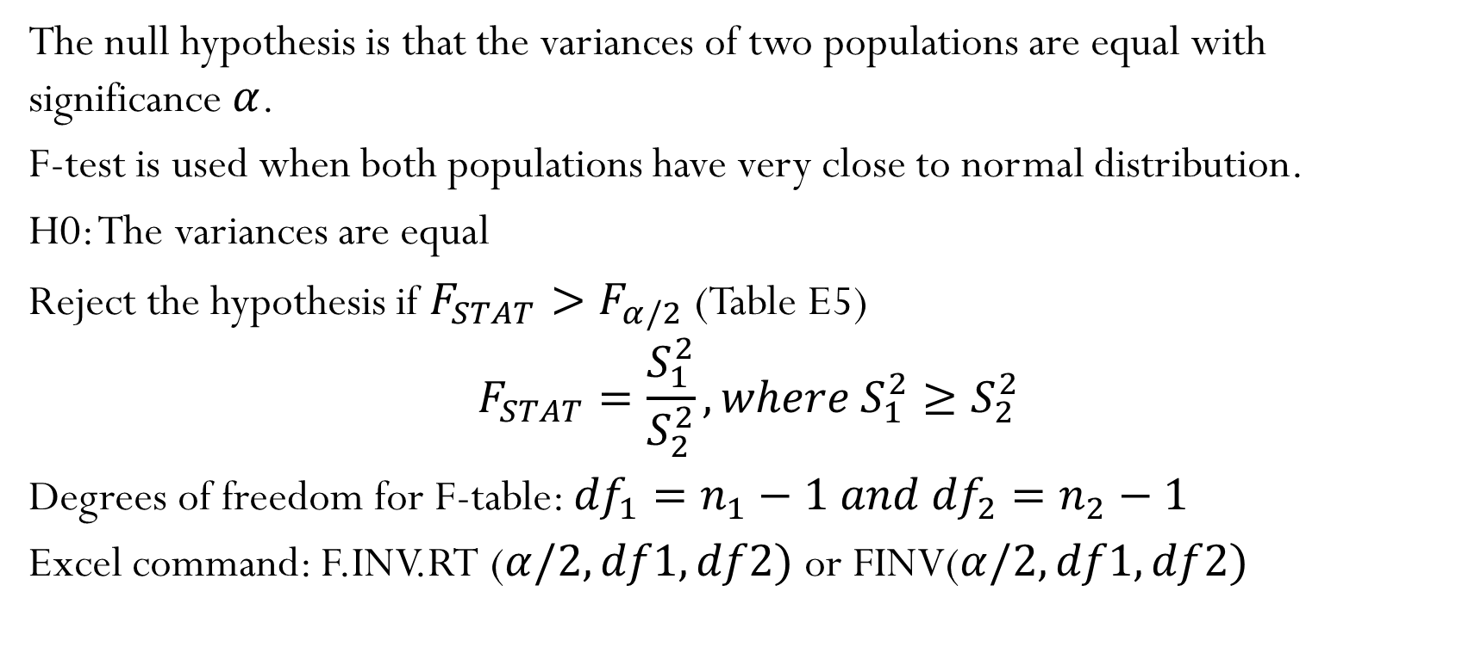
F-test for ratio of two variances
The null hypothesis is that the variances of two populations are equal with significance $α$.
F-test is used when both populations have very close to normal distribution.
H0: The variances are equal
Reject the hypothesis if $F_{STAT}>F_{α/2}$ (Table E5)
$$F_{STAT}=\frac{S_{1}^{2}}{S_{2}^{2}}, where{ S}_{1}^{2}≥S_{2}^{2}$$
Degrees of freedom for F-table: ${df}_{1}=n_{1}−1 and {{df}_{2}=n}_{2}−1$
Excel command: F.INV.RT ($α/2,df1,df2)$ or FINV($α/2,df1,df2)$

Slide 6
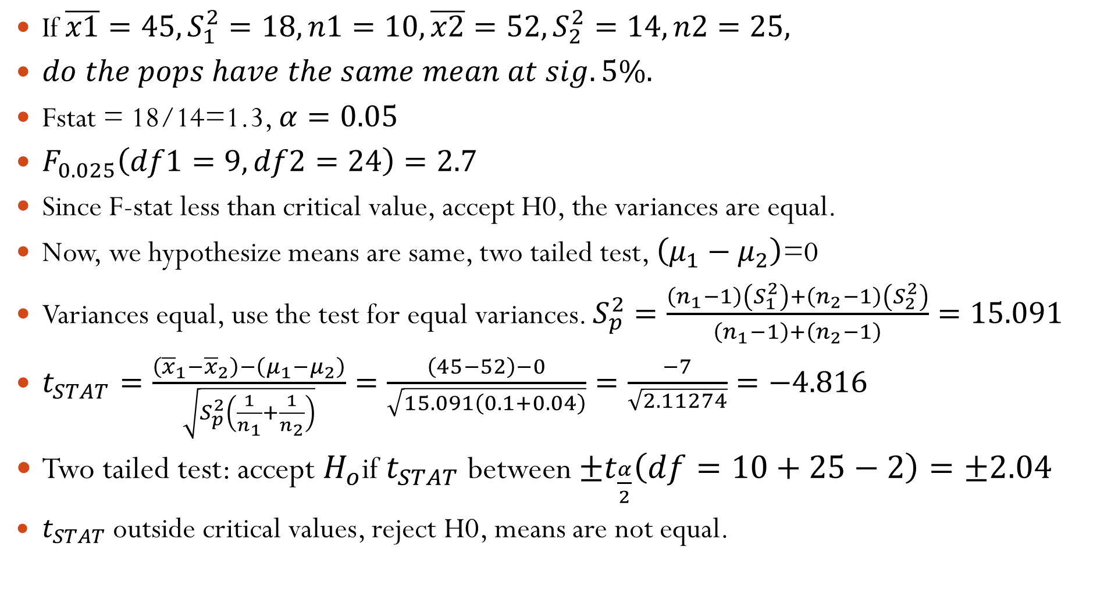
If $\overline{x1}=45, S_{1}^{2}=18, n1=10, {\overline{x2}=52, S}_{2}^{2}=14, n2=25,$
$do the pops have the same mean at sig. 5\%.$
Fstat = 18/14=1.3, $α=0.05$
$F_{0.025}\left(df1=9, df2=24\right)=2.7$
Since F-stat less than critical value, accept H0, the variances are equal.
Now, we hypothesize means are same, two tailed test, $\left(μ_{1}−μ_{2}\right)$=0
Variances equal, use the test for equal variances. $S_{p}^{2}=\frac{\left(n_{1}−1\right)\left(S_{1}^{2}\right)+\left(n_{2}−1\right)\left(S_{2}^{2}\right)}{\left(n_{1}−1\right)+\left(n_{2}−1\right)}=15.091$
$t_{STAT}=\frac{\left({\overline{x}}_{1}−{\overline{x}}_{2}\right)−\left(μ_{1}−μ_{2}\right)}{\sqrt{S_{p}^{2}\left(\frac{1}{n_{1}}+\frac{1}{n_{2}}\right)}}=\frac{\left(45−52\right)−0}{\sqrt{15.091\left(0.1+0.04\right)}}=\frac{−7}{\sqrt{2.11274}}=−4.816$
Two tailed test: accept $H_{o}$if $t_{STAT}$ between $±t_{\frac{α}{2}}\left(df=10+25−2\right)=±2.04$
$t_{STAT}$ outside critical values, reject H0, means are not equal.

Slide 7
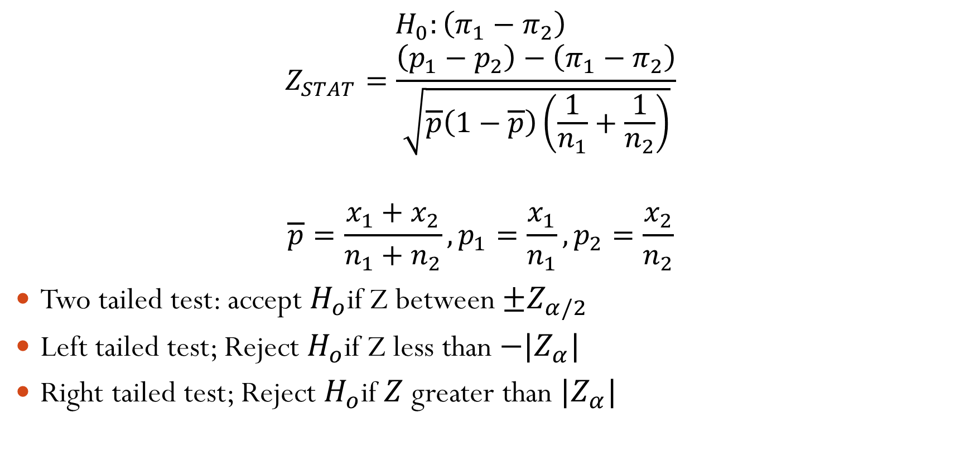
Comparing difference in proportion, Z-test,
$$H_{0}:\left(π_{1}−π_{2}\right)$$
$$Z_{STAT}=\frac{\left(p_{1}−p_{2}\right)−\left(π_{1}−π_{2}\right)}{\sqrt{\overline{p}\left(1−\overline{p}\right)\left(\frac{1}{n_{1}}+\frac{1}{n_{2}}\right)}}$$
$$\overline{p}=\frac{x_{1}+x_{2}}{n_{1}+n_{2}},p_{1}=\frac{x_{1}}{n_{1}},p_{2}=\frac{x_{2}}{n_{2}}$$
Two tailed test: accept $H_{o}$if Z between $±Z_{α/2}$
Left tailed test; Reject $H_{o}$if Z less than $−|Z_{α}|$
Right tailed test; Reject $H_{o}$if $Z$ greater than $|Z_{α}|$

Slide 8

Confidence interval for difference between two proportions
For significance level $α$, the confidence interval for the difference of two proportions:
$\left(π_{1}−π_{2}\right)$ falls between the values:
$$\left(p_{1}−p_{2}\right)±Z_{α/2}\sqrt{\left(\frac{p_{1}(1−p_{1}) }{n_{1}}+\frac{p_{2}(1−p_{2})}{n_{2}}\right)},$$

